Slide 1
Securing Content with Row Level Security
Notes:
The module begins by explaining how Azure Active Directory provides tenant-level support for managing user accounts and groups. Students will learn what is possible in terms of sharing content within an organization as well as across organizational boundaries. The module explains how to administrate the Power BI environment at the tenant level and demonstrates how to monitor usage of reports and dashboards using Power BI audit logs. The module explains how to use row-level security (RLS) by creating security roles in a Power BI Desktop project and writing DAX table filter expressions. The module also examines securing Power BI Desktop projects using a more flexible strategy in which an RLS security role filtered using the USERNAME function in DAX together with a custom table that associates users with the data they are allows to access.

Slide 2
Agenda
User Authentication and Identity
Power BI Tenant Administration
Row Level Security
Dynamic Row Level Security
Embedding RLS-enabled Reports

Slide 3
Power BI Built on Azure Active Directory
Azure AD manages identity in Microsoft cloud
Organization creates user accounts & groups in Azure AD
Users accounts and groups created in scope of tenant
Azure AD provides user authentication service
Azure AD manages licensing and permissions
Provides users authorized access to Office 365
Provides users authorized access to SharePoint Online
Provides users authorized access to Dynamics 365
Provides users authorized access to Power BI

Slide 4
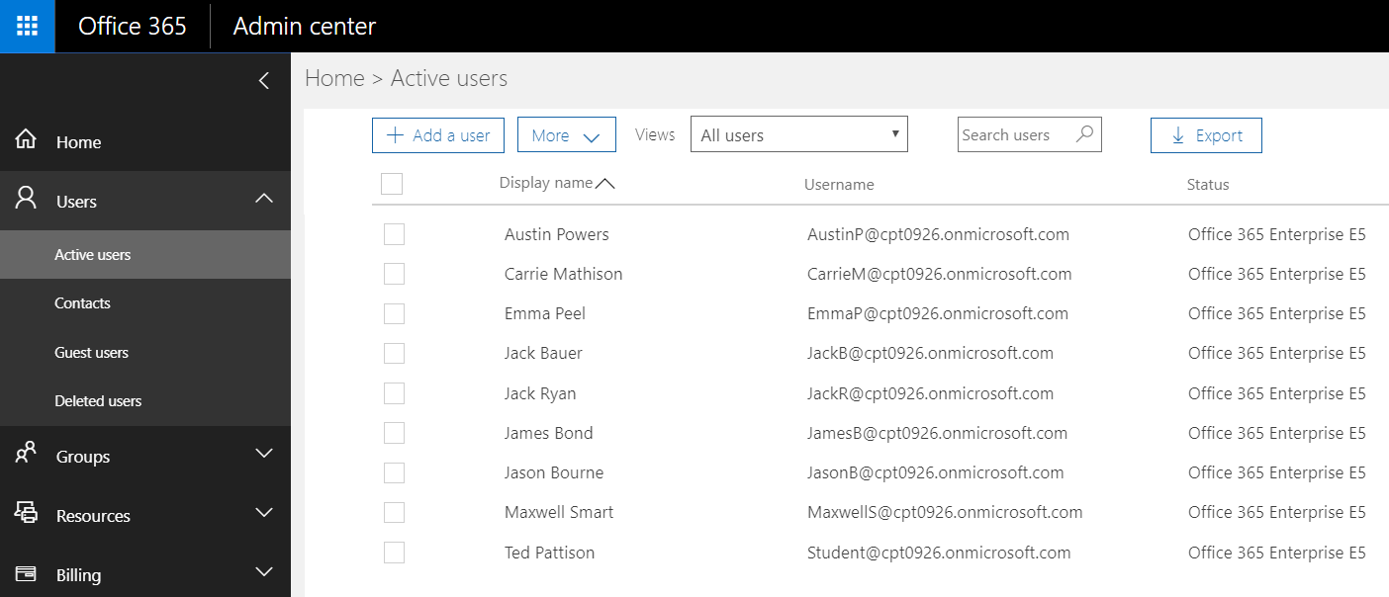
Azure AD User Accounts and Licensing
User account created within scope of tenant
Office 365 admin create accounts and assigns licenses

Slide 5
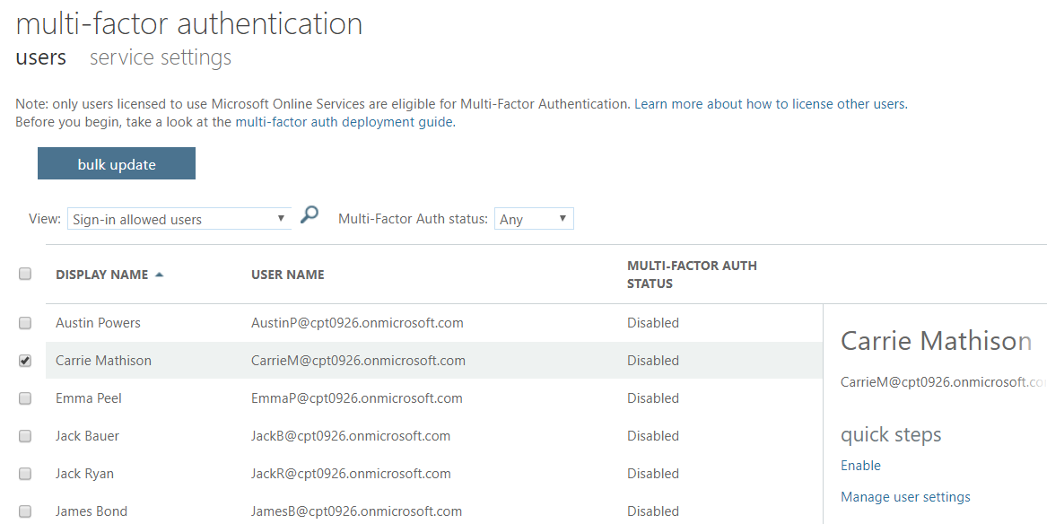
Multifactor Authentication
Enabled through admin portal
Requires Office 365 or Azure AD Premium

Slide 6
Agenda
User Authentication and Identity
Power BI Tenant Administration
Row Level Security
Dynamic Row Level Security
Embedding RLS-enabled Reports

Slide 7
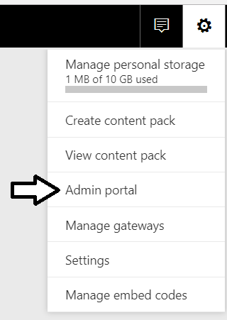
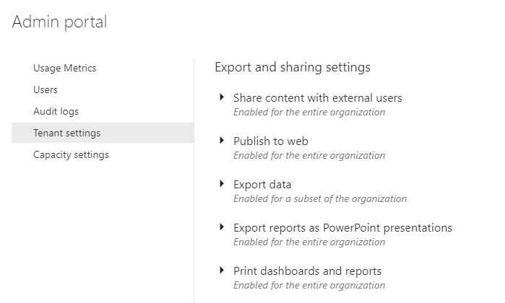
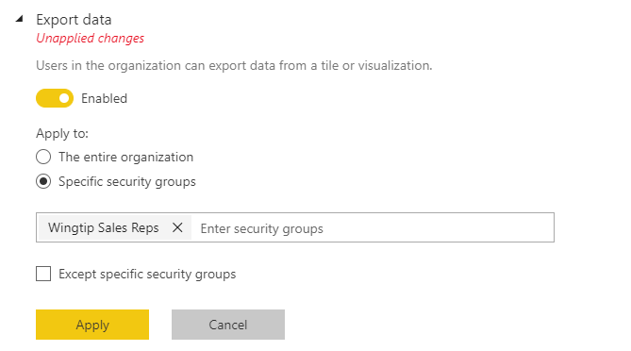
Power BI Admin Portal
Power BI Admins control tenant-level settings
Control whether users can self-register for Power BI
Control who can publish to web
Control who can export & share content
Control who can create content packs

Slide 8
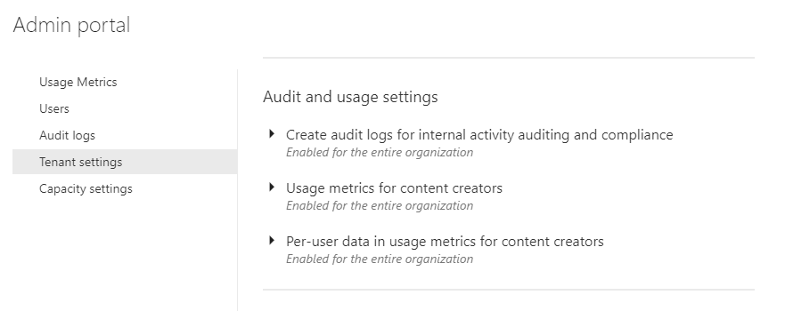
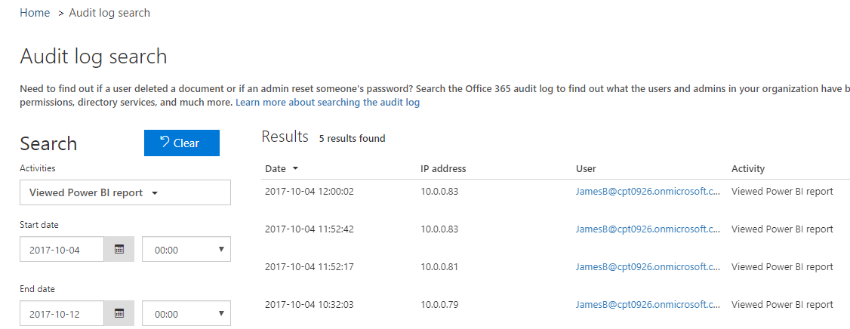
Power BI Audit Log

Slide 9
Agenda
User Authentication and Identity
Power BI Tenant Administration
Row Level Security
Dynamic Row Level Security
Embedding RLS-enabled Reports

Slide 10
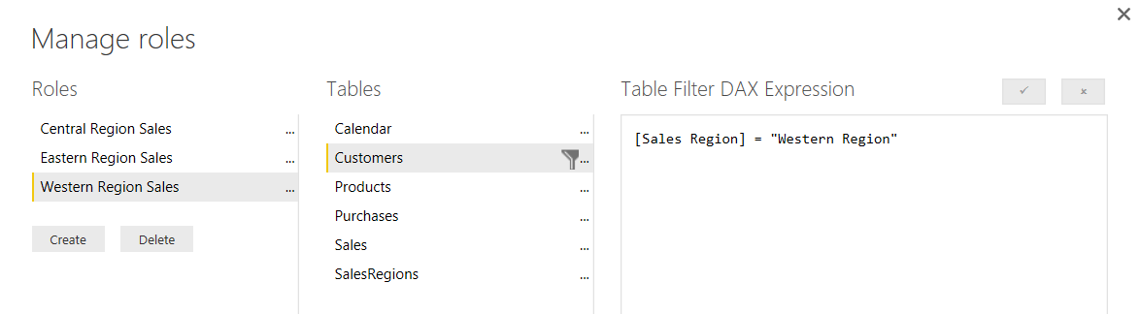
What Is Row-level Security (RLS)
Security Scheme based on Named Roles
Roles are defined using Power BI Desktop
Each role is scoped to the dataset within a PBIX project
Role defined using one or more DAX expressions
DAX expressions restrict which rows are accessible

Slide 11
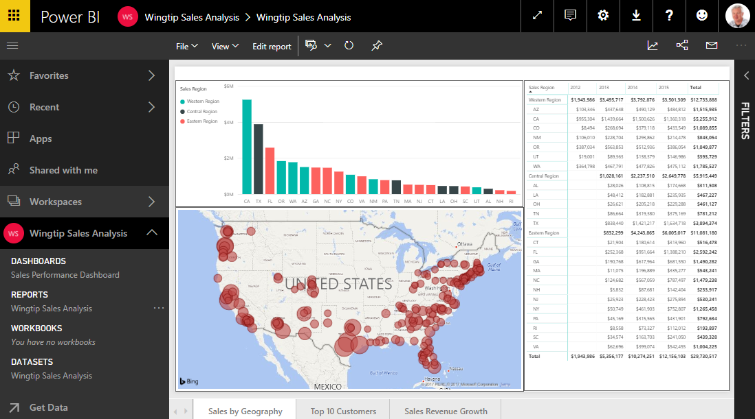
Common RLS Scenario

Slide 12
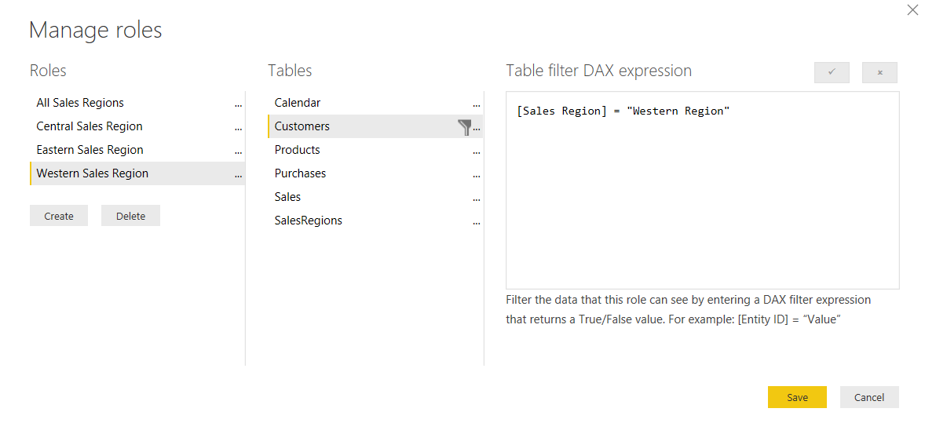
Configuring RLS in the Power BI Desktop

Slide 13
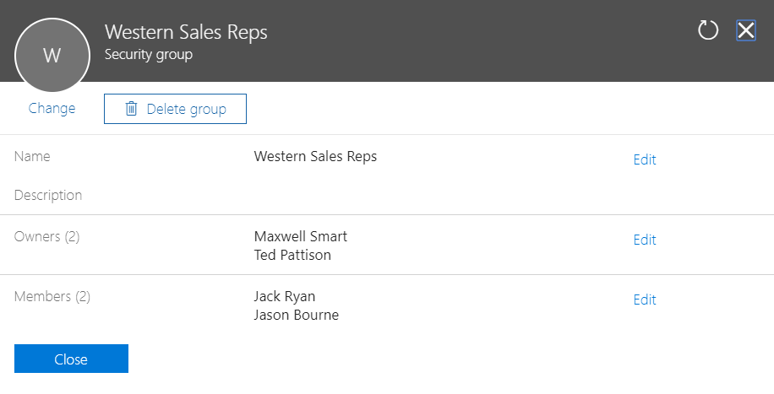
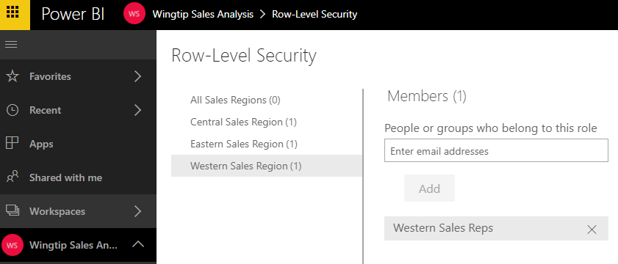
Configuring RLS in the Power BI Service

Slide 14
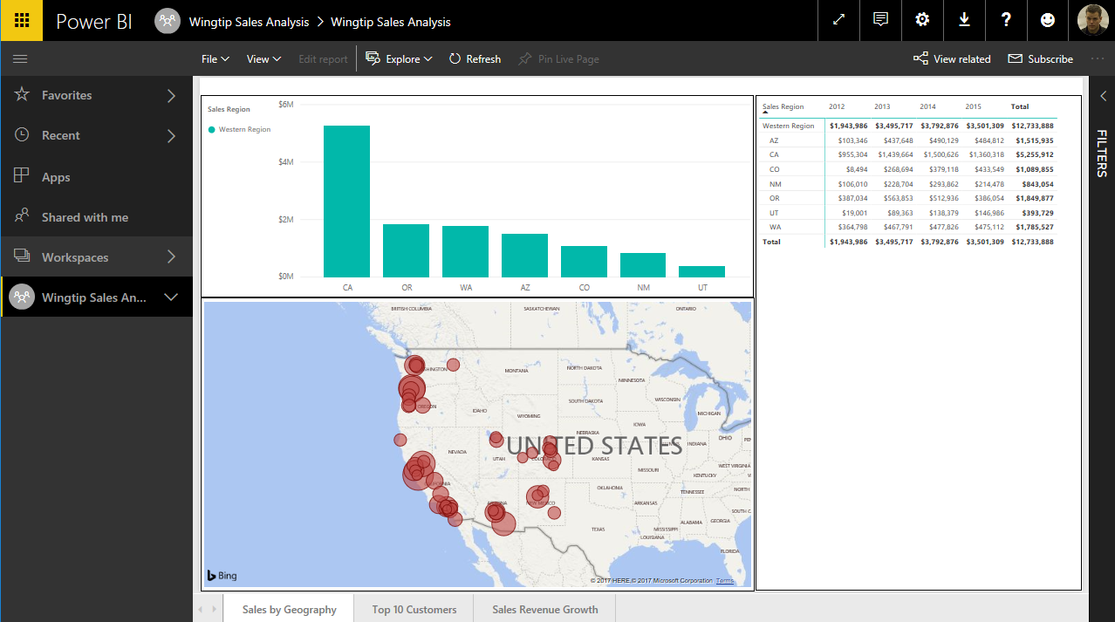
RLS Enforcement

Slide 15
Configuring Row-level Security

Slide 16
Agenda
User Authentication and Identity
Power BI Tenant Administration
Row Level Security
Dynamic Row Level Security
Embedding RLS-enabled Reports

Slide 17
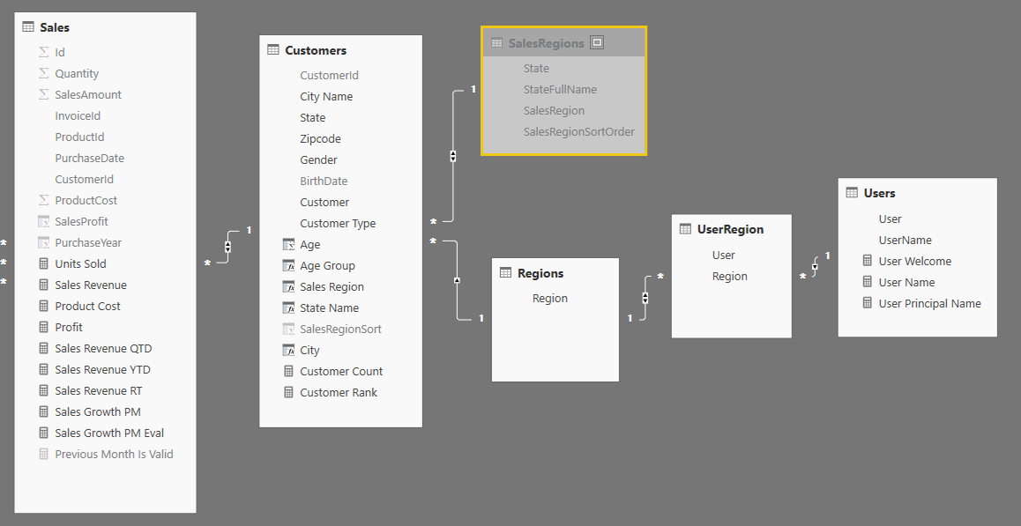
Dynamic RLS
Design pattern for data-driven security
RLS set up to use login name of current user
Permission assignments are included as part of dataset
Implemented using bi-directional cross-filtering

Slide 18
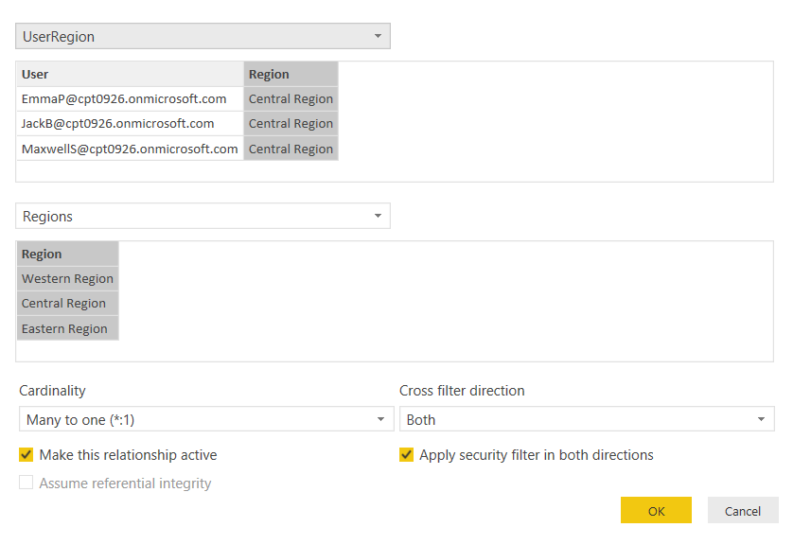
Configuring Cross-direction Filtering

Slide 19
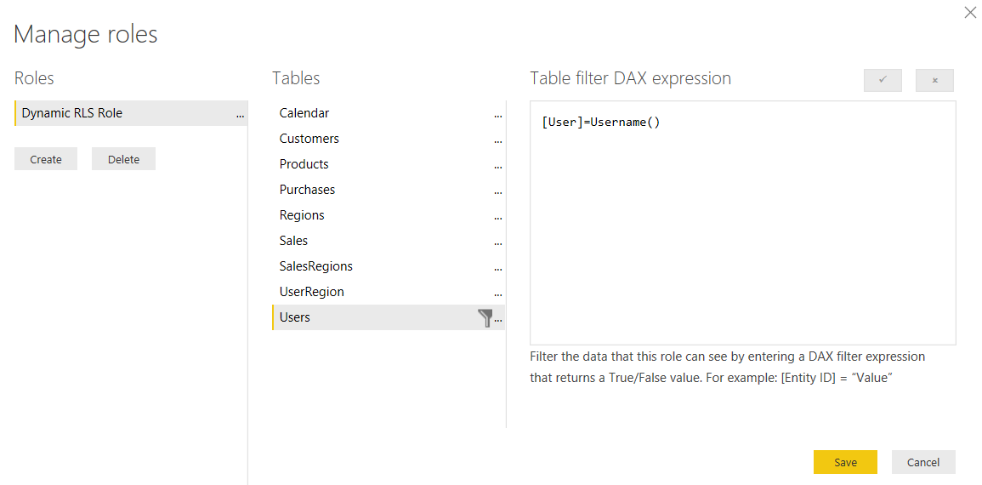
Dynamically Tracking the Current User

Slide 20
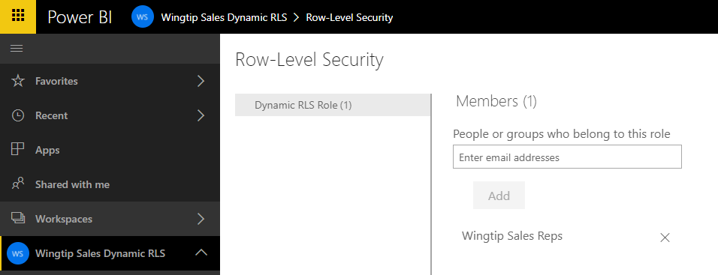
All Users Must Be Added To a Role

Slide 21
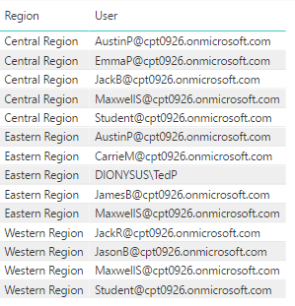
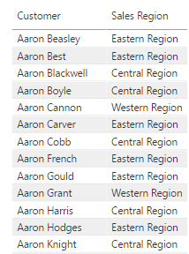
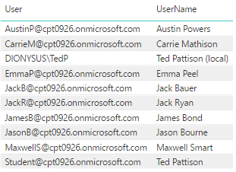

Dynamic RLS Table Filtering
UserRegion
Customers
Users
Users

Slide 22
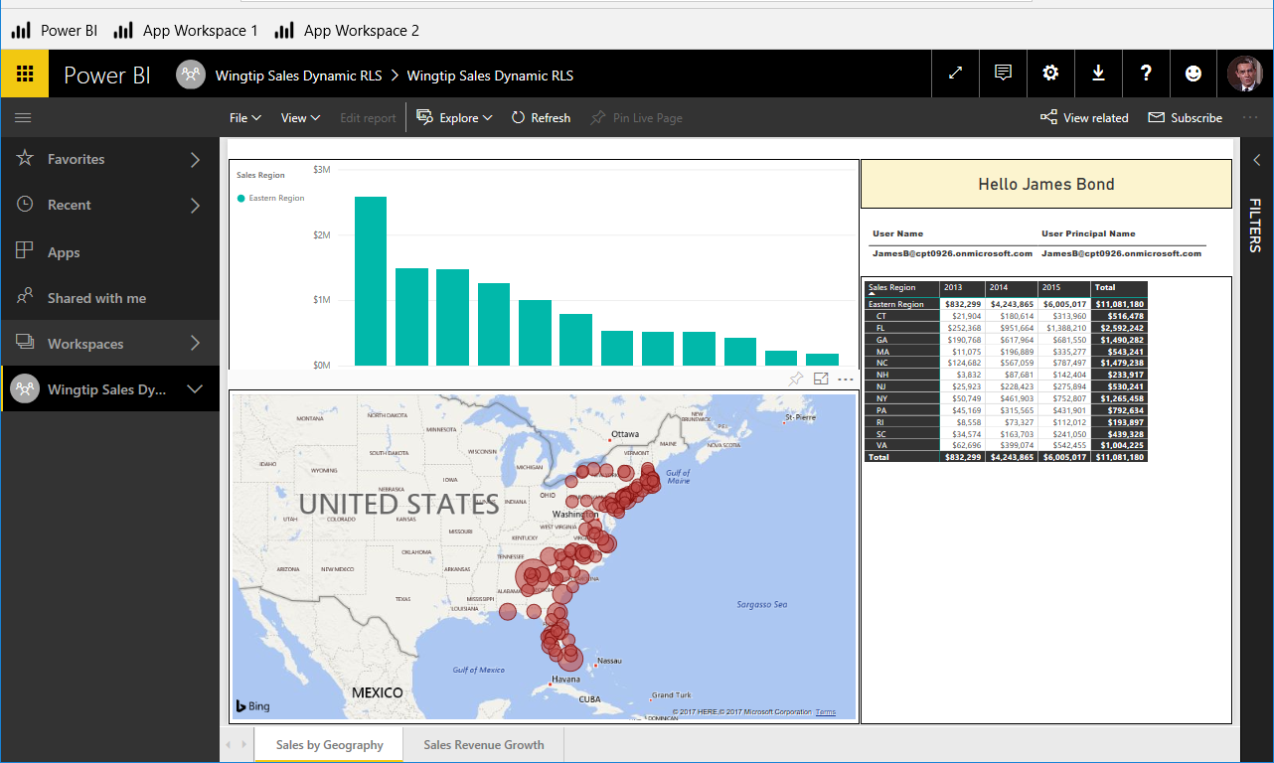
Dynamic RLS Enforcement

Slide 23
Configuring Dynamic Row-level Security

Slide 24
Agenda
User Authentication and Identity
Power BI Tenant Administration
Row Level Security
Dynamic Row Level Security
Embedding RLS-enabled Reports

Slide 25
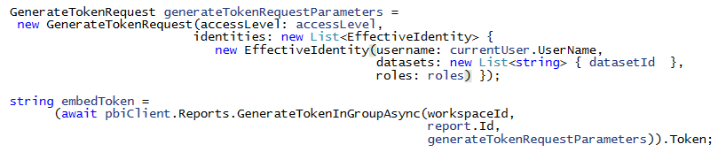
Embedding RLS-enabled Reports
Programming with EffectiveIdentity
RLS-enabled reports require role(s) for access
Embed tokens must be generated with 1 or more roles
Roles added to embed token using EffectiveIdentity

Slide 26
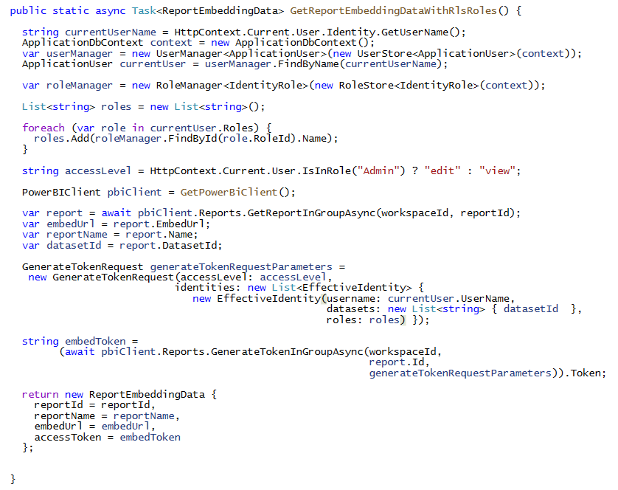
Programming with EffectiveIdentity

Slide 27
Summary
User Authentication and Identity
Power BI Tenant Administration
Row Level Security
Dynamic Row Level Security
Embedding RLS-enabled Reports

